Slide 1
Median Prices for Existing Family Homes

Slide 2
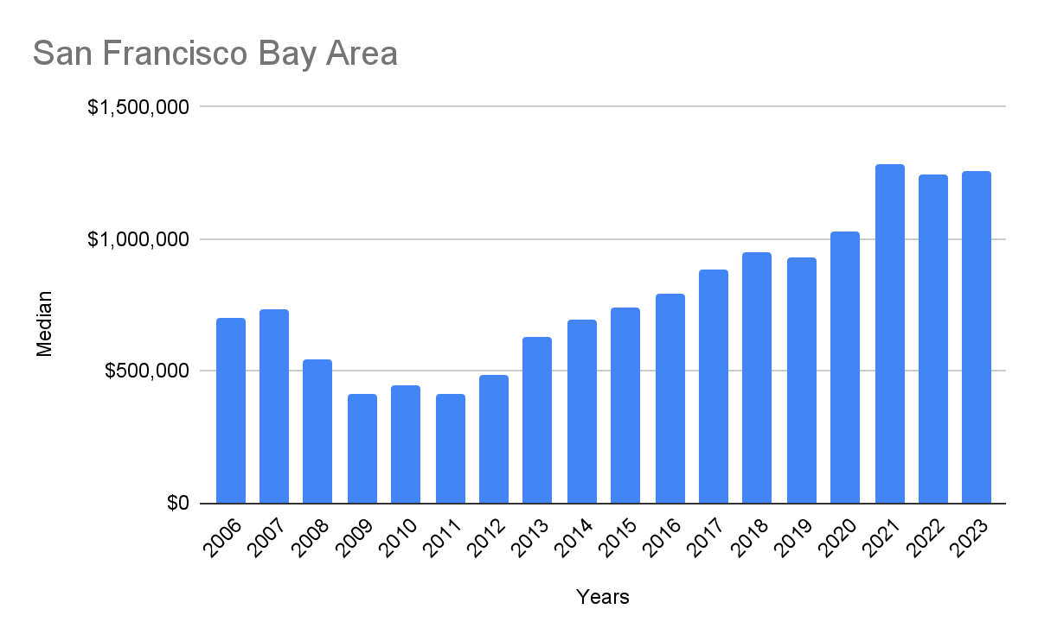
www.JinesRE.com - Nathan@JinesRE.com - Phone: 510-220-4714

Slide 3
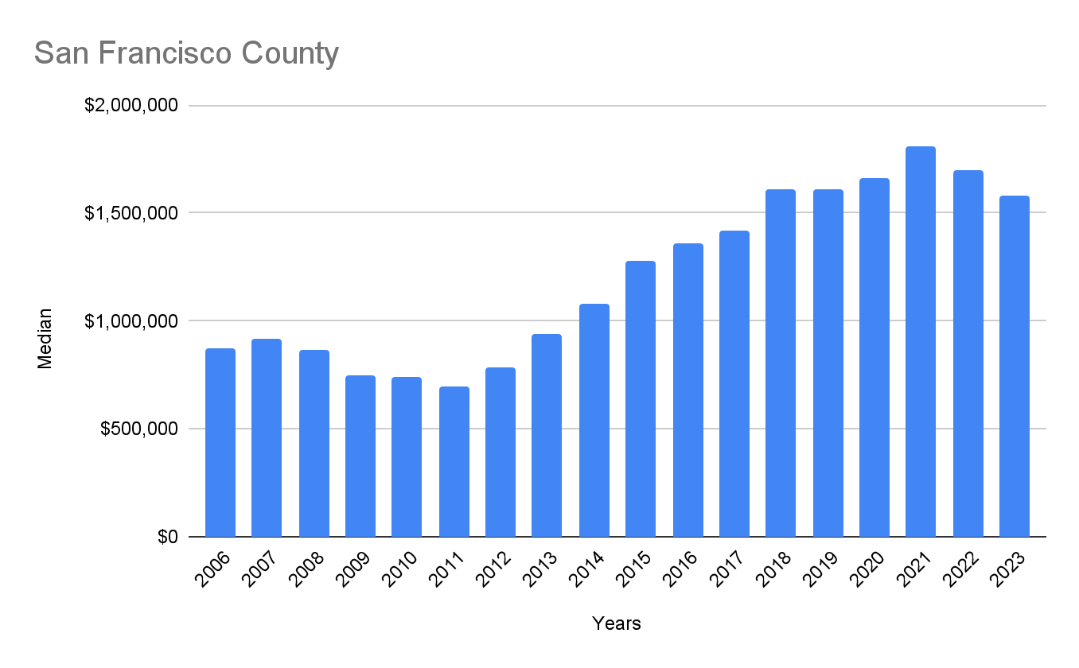
www.JinesRE.com - Nathan@JinesRE.com - Phone: 510-220-4714

Slide 4
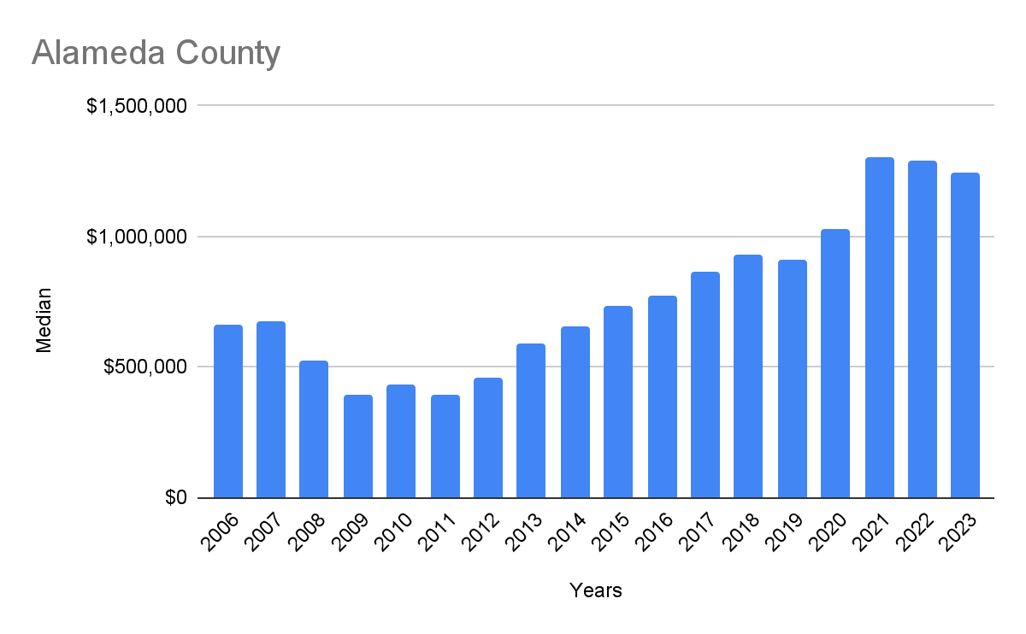
www.JinesRE.com - Nathan@JinesRE.com - Phone: 510-220-4714

Slide 5
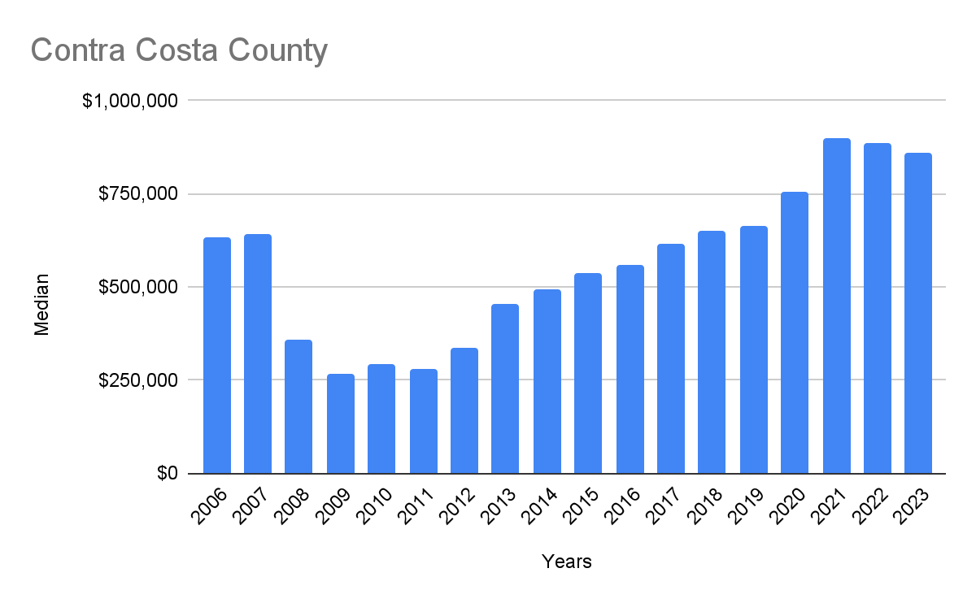
www.JinesRE.com - Nathan@JinesRE.com - Phone: 510-220-4714

Slide 7
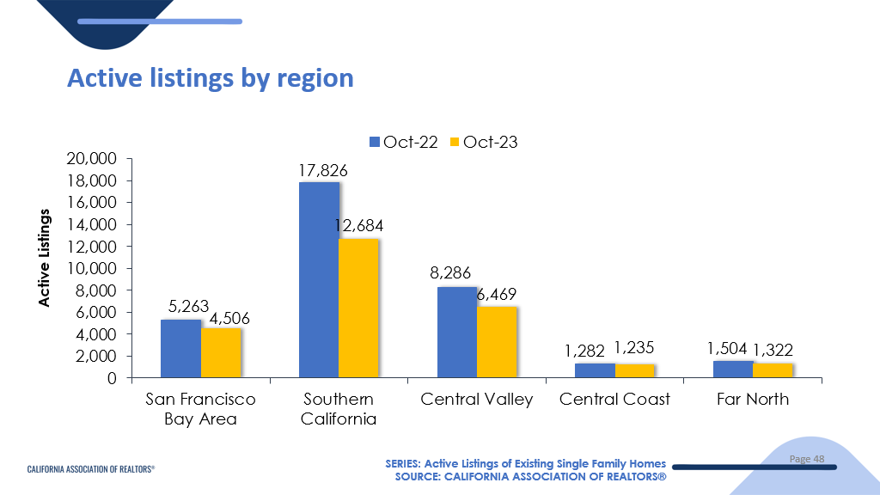

Slide 8
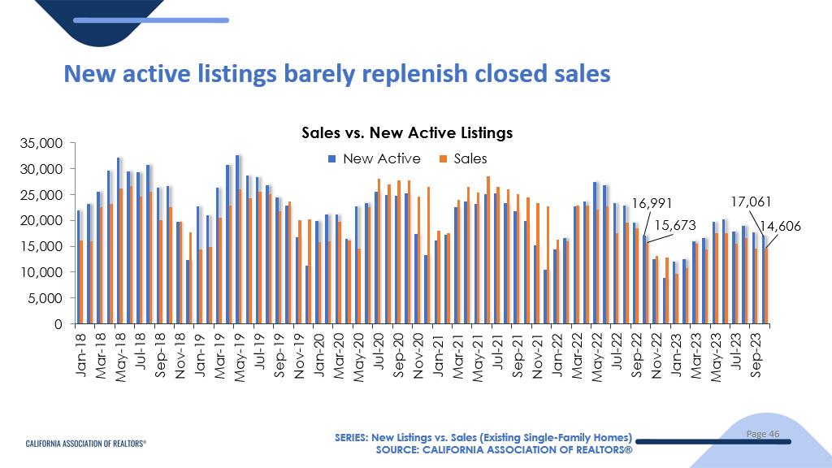

Slide 9
Diablo Valley
www.JinesRE.com - Nathan@JinesRE.com - Phone: 510-220-4714

Slide 10
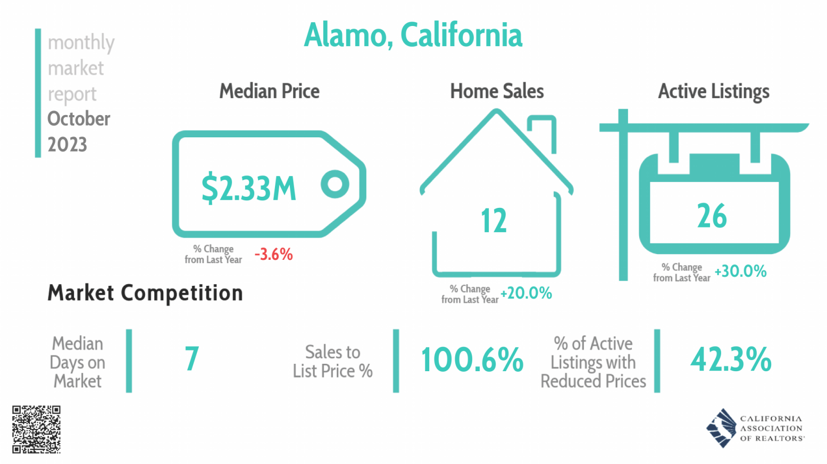

Slide 12
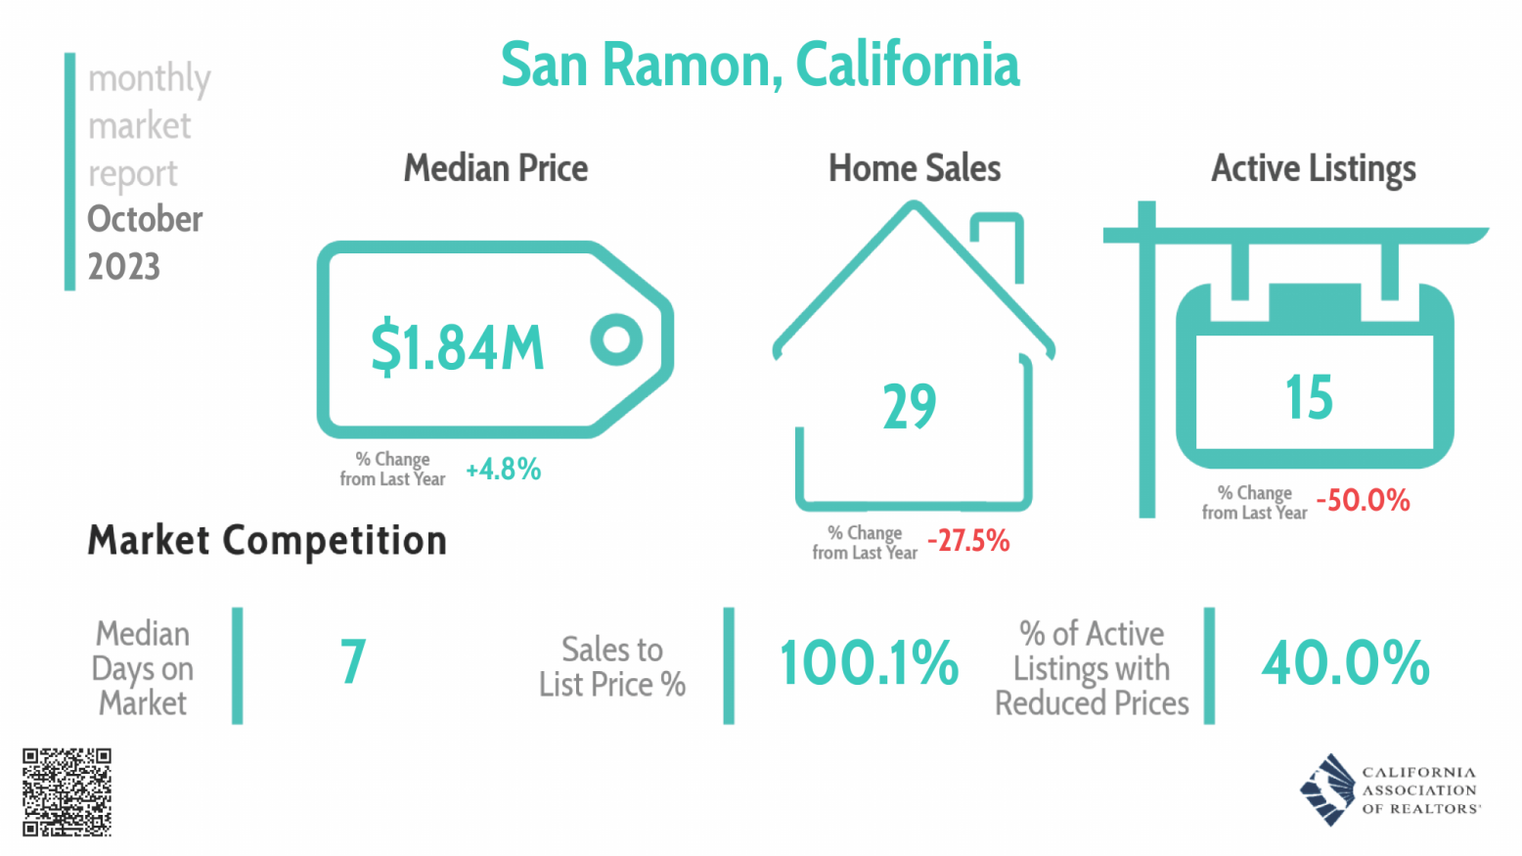

Slide 17
Most Expensive vs Most Affordable
www.JinesRE.com - Nathan@JinesRE.com - Phone: 510-220-4714

Slide 18
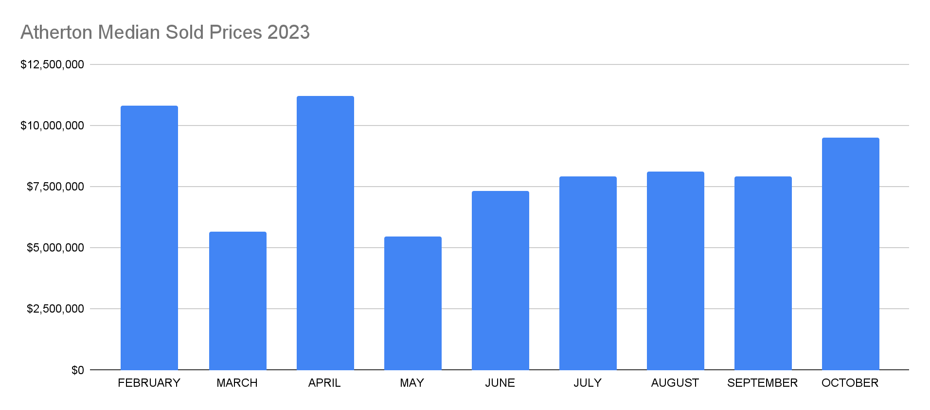
www.JinesRE.com - Nathan@JinesRE.com - Phone: 510-220-4714

Slide 20
BAY AREA
www.JinesRE.com - Nathan@JinesRE.com - Phone: 510-220-4714

Slide 21
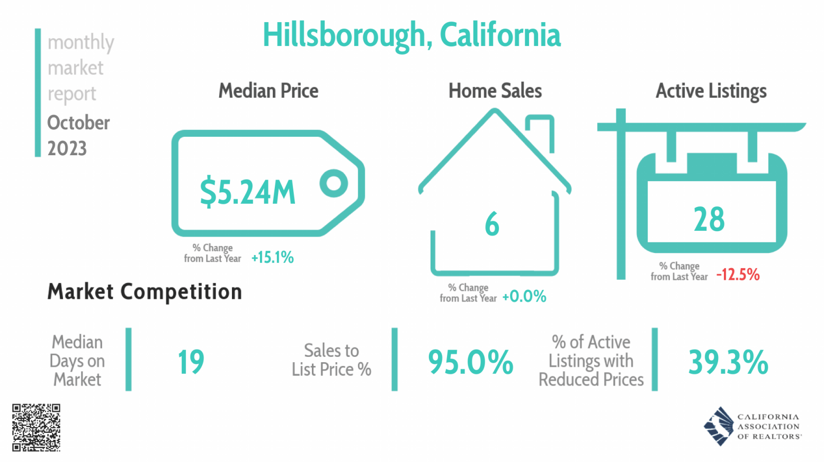

Slide 22
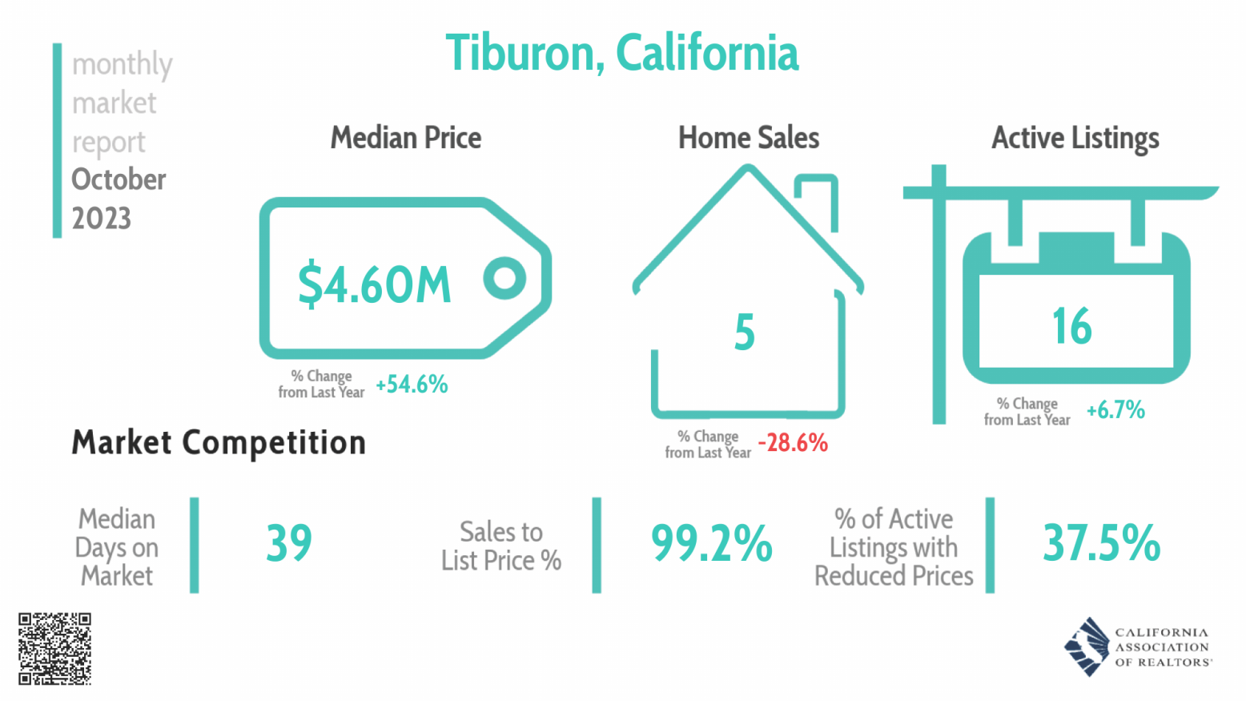

Slide 27
Jines Real Estate Group
www.JinesRE.com - Nathan@JinesRE.com - Phone: 510-220-4714

Slide 28
“We know how hard you have worked to get where you are. So when it's time to buy or sell, you should be able to lean on someone else. We relieve the pressure with results-oriented advice and an exclusive service experience."
Nathan Jines
www.JinesRE.com - Nathan@JinesRE.com - Phone: 510-220-4714

Slide 29
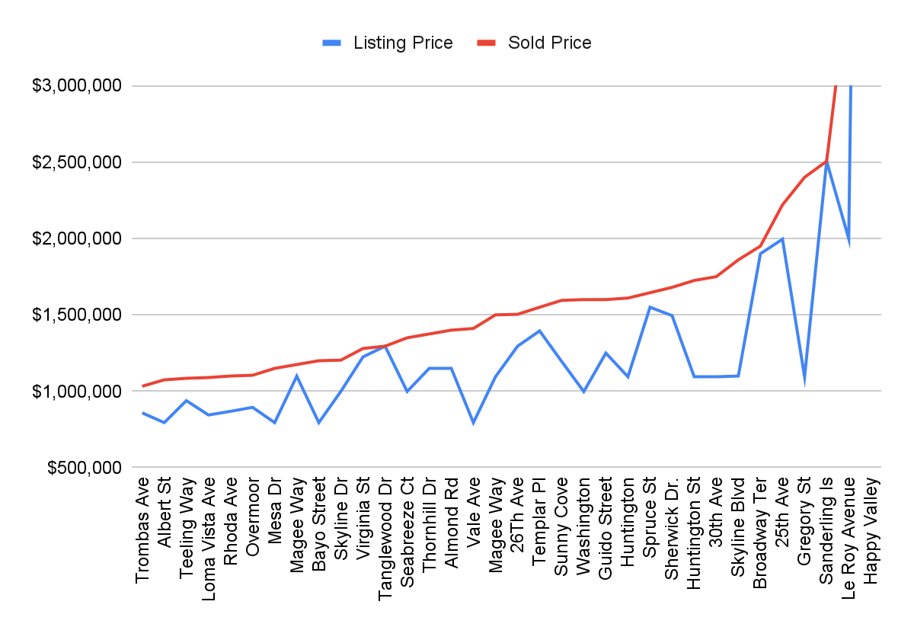
www.JinesRE.com - Nathan@JinesRE.com - Phone: 510-220-4714

Slide 30
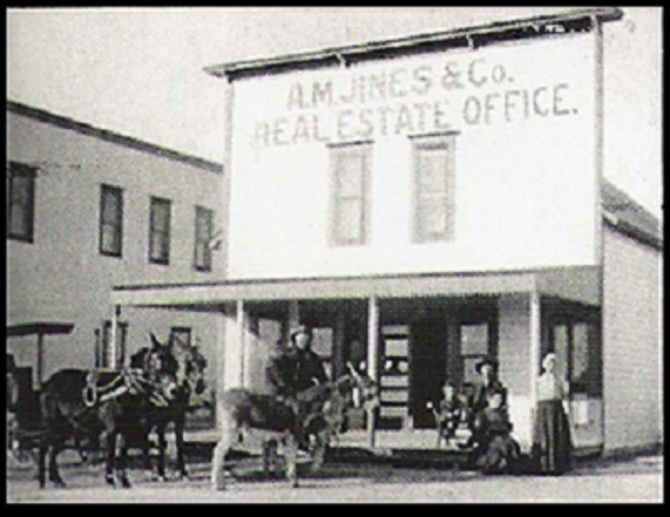
www.JinesRE.com - Nathan@JinesRE.com - Phone: 510-220-4714

Slide 32
Q&A Contact Details
www.JinesRE.com
Nathan@JinesRE.com
Phone: 510-220-4714
Notes:
5% 6% 7%
buy down
15,500 per point on a
2/1 buy down
5 for one year, second year 6, then regular rate
permanently to buy it down
7% at 970k
lowest you can buy it down is 5.5%— $61,000 permanent buy down — 6% of the purchase price for seller credit
go to a rate calculator — difference in payment between 5% and 6%
— goes into account— which pays down extra
— if rates fall to 5% in a year, it goes to pay down the $$$— refinances or sell,
—

